Slide 1
Assignment 2

Slide 2


1
2
3
4

Slide 3
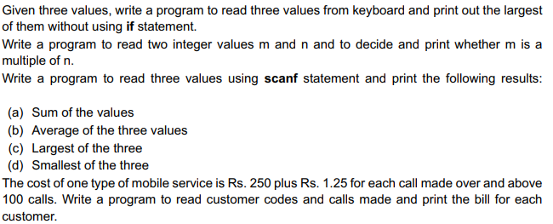
5
6
7
8

Slide 4
